Slide 1


How I Built a Telegram Reminder Bot
to Stay on Track with NTU SCTP DSAI Classes
Zhi Hao

Slide 2





The Challenge: Staying on Track
Attendance QR codes must be scanned within a 30-minute window before/after
Keeping track of class schedules and location over the course duration
Accessing course materials quickly when needed
Excessive missing attendance affects course completion

Slide 3




The Solution: An Automated Reminder System
Automatically remind me of upcoming classes
Provide
easy access
to course materials
Work directly within
Telegram
app
Pain Point Solved
No more digging through emails or NTULearn website. Everything in one bot.

Slide 4




Key Features of the Reminder Bot
🗓 Class Reminders
✅ Attendance Instructions
📥 Material Fetching
🔁 Daily Refresh
Syncs with Google Sheet data
Alerts 30 minutes before class and at class end for attendance
Attendance QR code links
Links to course materials
Updates at 23:00 SGT
Timely submission reminders
Quick access to GitHub resources

Slide 5

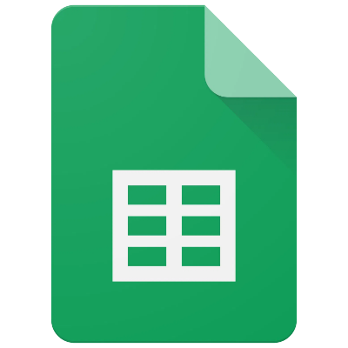




Design Behind the Bot
python-telegram-bot
Google Sheets
SQLite
Framework for Telegram bots
Schedule data source
Lightweight database
APScheduler
Google Compute Engine
Systemd
Jobs scheduler
Virtual Machine
Service management

Slide 6

Development Approach: AI-assisted coding
(or maybe Vibe Coding)
1
Spec First
Clear program description refined using GitHub Copilot
2
Build
Generated scripts for scheduling and response logic using GitHub Copilot
3
Test and Debug
Test by simulating reminders and message flow (no unit testing)
4
Deploy
GCE VM with systemd for background execution
(No container deployment)

Slide 7






Key takeaways
Telegram Bots Are Powerful
Easy-to-use and user-friendly
Cloud Hosting Considerations
Google Cloud is versatile
Google (Free tier) is the most generous cloud services.
AI-Assisted Development
GitHub Copilot make coding easier and reduced development time
https://t.me/ds2_reminder_bot
https://github.com/zey-2/TG_reminder_bot

